Slide 1
Statistics for
Business and Economics 8th Edition
Chapter 1
Describing Data: Graphical

Slide 2
Chapter Goals
After completing this chapter, you should be able to:
Explain how decisions are often based on incomplete information
Explain key definitions:
♦ Population vs. Sample
♦ Parameter vs. Statistic
♦ Descriptive vs. Inferential Statistics
Describe random sampling and systematic sampling
Explain the difference between Descriptive and Inferential statistics
Identify types of data and levels of measurement

Slide 3
Chapter Goals
(continued)
After completing this chapter, you should be able to:
Create and interpret graphs to describe categorical variables:
frequency distribution, bar chart, pie chart, Pareto diagram
Create a line chart to describe time-series data
Create and interpret graphs to describe numerical variables:
frequency distribution, histogram, ogive, stem-and-leaf display
Construct and interpret graphs to describe relationships between variables:
Scatter plot, cross table
Describe appropriate and inappropriate ways to display data graphically

Slide 4
Decision Making in an Uncertain Environment
1.1
Everyday decisions are based on incomplete information
Examples:
Will the job market be strong when I graduate?
Will the price of Yahoo stock be higher in six months than it is now?
Will interest rates remain low for the rest of the year if the federal budget deficit is as high as predicted?

Slide 5
Decision Making in an Uncertain Environment
(continued)
Data are used to assist decision making
Statistics is a tool to help process, summarize, analyze, and interpret data

Slide 6
Key Definitions
A population is the collection of all items of interest or under investigation
N represents the population size
A sample is an observed subset of the population
n represents the sample size
A parameter is a specific characteristic of a population
A statistic is a specific characteristic of a sample

Slide 7
Population vs. Sample
Population
Sample
Values calculated using population data are called parameters
Values computed from sample data are called statistics

Slide 8
Examples of Populations
Names of all registered voters in the United States
Incomes of all families living in Daytona Beach
Annual returns of all stocks traded on the New York Stock Exchange
Grade point averages of all the students in your university

Slide 9
Random Sampling
Simple random sampling is a procedure in which
each member of the population is chosen strictly by chance,
each member of the population is equally likely to be chosen,
every possible sample of n objects is equally likely to be chosen
The resulting sample is called a random sample

Slide 10
Systematic Sampling
For systematic sampling,
Assure that the population is arranged in a way that is not related to the subject of interest
Select every j^{th} item from the population…
…where j is the ratio of the population size to the sample size, j = N/n
Randomly select a number from 1 to j for the first item selected
The resulting sample is called a systematic sample

Slide 11
Systematic Sampling
(continued)
Example:
Suppose you wish to sample n = 9 items from a population of N = 72.
j = N / n = 72 / 9 = 8
Randomly select a number from 1 to 8 for the first item to include in the sample; suppose this is item number 3.
Then select every 8th item thereafter
(items 3, 11, 19, 27, 35, 43, 51, 59, 67)

Slide 12
Descriptive and Inferential Statistics
Two branches of statistics:
Descriptive statistics
Graphical and numerical procedures to summarize and process data
Inferential statistics
Using data to make predictions, forecasts, and estimates to assist decision making

Slide 13
Descriptive Statistics
Collect data
e.g., Survey
Present data
e.g., Tables and graphs
Summarize data
e.g., Sample mean =

Slide 14
Inferential Statistics
Estimation
e.g., Estimate the population mean weight using the sample mean weight
Hypothesis testing
e.g., Test the claim that the population mean weight is 140 pounds
Inference is the process of drawing conclusions or making decisions about a population based on sample results

Slide 15
Classification of Variables
1.2
Data
Categorical
Numerical
Examples:
Marital Status
Are you registered to vote?
Eye Color
(Defined categories or groups)
Discrete
Continuous
Examples:
Number of Children
Defects per hour
(Counted items)
Examples:
Weight
Voltage
(Measured characteristics)

Slide 16
Measurement Levels
Differences between measurements, true zero exists
Ratio Data
Quantitative Data
Differences between measurements but no true zero
Interval Data
Ordered Categories (rankings, order, or scaling)
Ordinal Data
Qualitative Data
Categories (no ordering or direction)
Nominal Data

Slide 17
Graphical Presentation of Data
1.3-1.5
Data in raw form are usually not easy to use for decision making
Some type of organization is needed
Table
Graph
The type of graph to use depends on the variable being summarized

Slide 18
Graphical Presentation of Data
(continued)
Techniques reviewed in this chapter:
Categorical
Variables
Numerical
Variables
Frequency distribution
Cross table
Bar chart
Pie chart
Pareto diagram
Line chart
Frequency distribution
Histogram and ogive
Stem-and-leaf display
Scatter plot

Slide 19
Tables and Graphs for Categorical Variables
1.3
Categorical Data
Tabulating Data
Graphing Data
Frequency Distribution Table
Bar Chart
Pie Chart
Pareto Diagram

Slide 20
The Frequency Distribution Table
Summarize data by category
Example: Hospital Patients by Unit
Hospital Unit Number of Patients Percent
(rounded)
Cardiac Care 1,052 11.93
Emergency 2,245 25.46
Intensive Care 340 3.86
Maternity 552 6.26
Surgery 4,630 52.50
Total: 8,819 100.0
(Variables are
categorical)

Slide 21
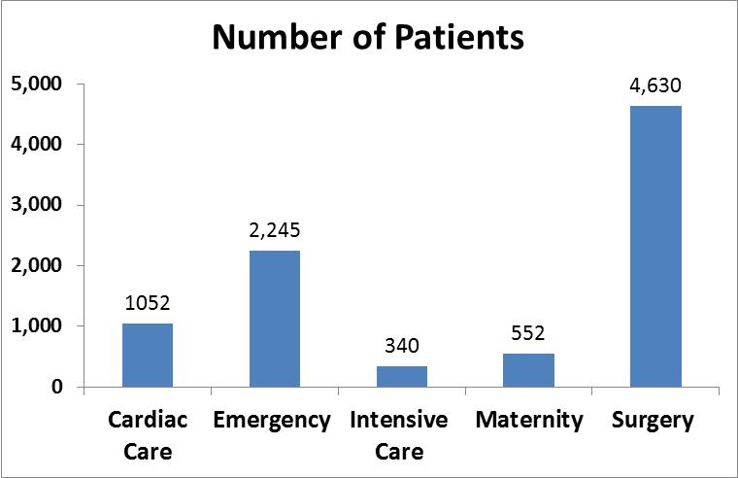
Graph of Frequency Distribution
Bar chart of patient data

Slide 22
Cross Tables
Cross Tables (or contingency tables) list the number of observations for every combination of values for two categorical or ordinal variables
If there are r categories for the first variable (rows) and c categories for the second variable (columns), the table is called an r x c cross table

Slide 23
Cross Table Example
3 x 3 Cross Table for Investment Choices by Investor (values in $1000’s)
Investment Investor A Investor B Investor C Total
Category
Stocks 46 55 27 128
Bonds 32 44 19 95
Cash 15 20 33 68
Total 93 119 79 291

Slide 24
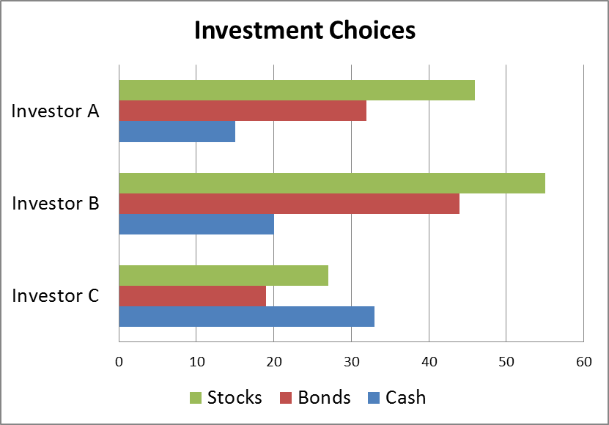
Graphing Multivariate Categorical Data
(continued)
Side by side horizontal bar chart

Slide 25
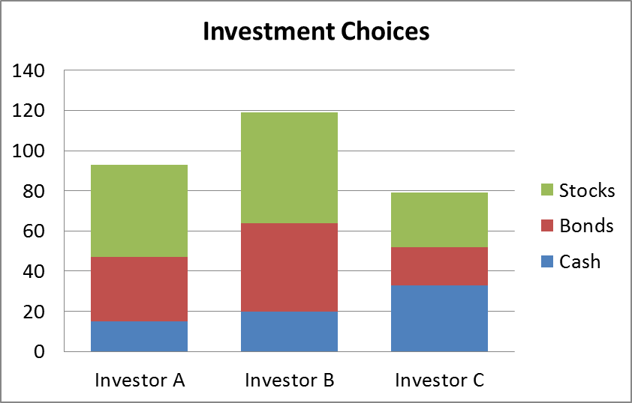
Graphing Multivariate Categorical Data
(continued)
Stacked bar chart

Slide 26
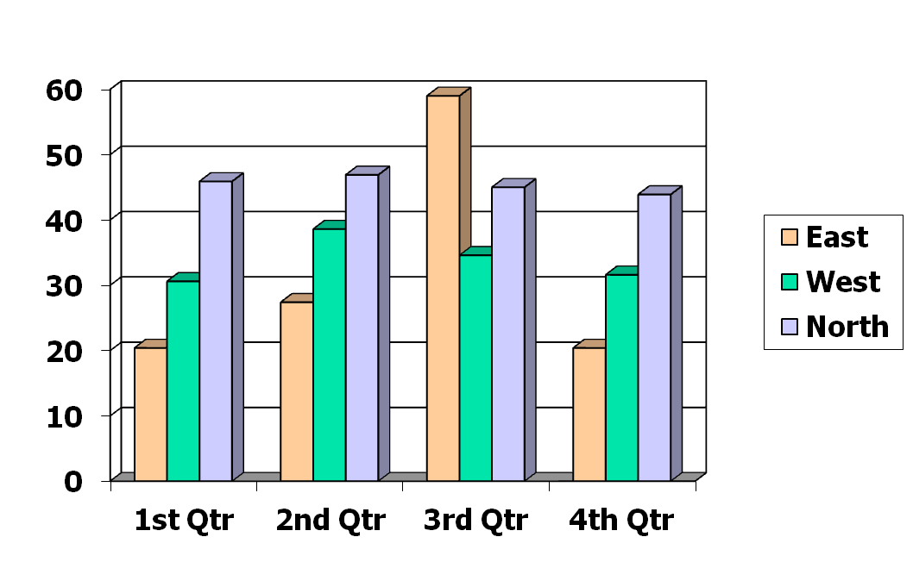
Vertical Side-by-Side Chart Example
Sales by quarter for three sales territories:

Slide 27
Bar and Pie Charts
Bar charts and Pie charts are often used for qualitative (categorical) data
Height of bar or size of pie slice shows the frequency or percentage for each category

Slide 28
Bar Chart Example
Hospital Number
Unit of Patients
Cardiac Care 1,052
Emergency 2,245
Intensive Care 340
Maternity 552
Surgery 4,630

Slide 29
Pie Chart Example
Hospital Number % of
Unit of Patients Total
Cardiac Care 1,052 11.93
Emergency 2,245 25.46
Intensive Care 340 3.86
Maternity 552 6.26
Surgery 4,630 52.50
(Percentages are rounded to the nearest percent)

Slide 30
Pareto Diagram
Used to portray categorical data
A bar chart, where categories are shown in descending order of frequency
A cumulative polygon is often shown in the same graph
Used to separate the “vital few” from the “trivial many”

Slide 31
Pareto Diagram Example
Example: 400 defective items are examined
for cause of defect:
Source of Manufacturing Error | Number of defects
Bad Weld | 34
Poor Alignment | 223
Missing Part | 25
Paint Flaw | 78
Electrical Short | 19
Cracked case | 21
Total | 400

Slide 32
Pareto Diagram Example
(continued)
Step 1: Sort by defect cause, in descending order
Step 2: Determine % in each category
Source of Manufacturing Error | Number of defects | % of Total Defects
Poor Alignment | 223 | 55.75
Paint Flaw | 78 | 19.50
Bad Weld | 34 | 8.50
Missing Part | 25 | 6.25
Cracked case | 21 | 5.25
Electrical Short | 19 | 4.75
Total | 400 | 100%

Slide 33
Pareto Diagram Example
(continued)
Step 3: Show results graphically
% of defects in each category (bar graph)
cumulative % (line graph)

Slide 34
Graphs to Describe Time-Series Data
1.4
A line chart (time-series plot) is used to show the values of a variable over time
Time is measured on the horizontal axis
The variable of interest is measured on the vertical axis

Slide 35
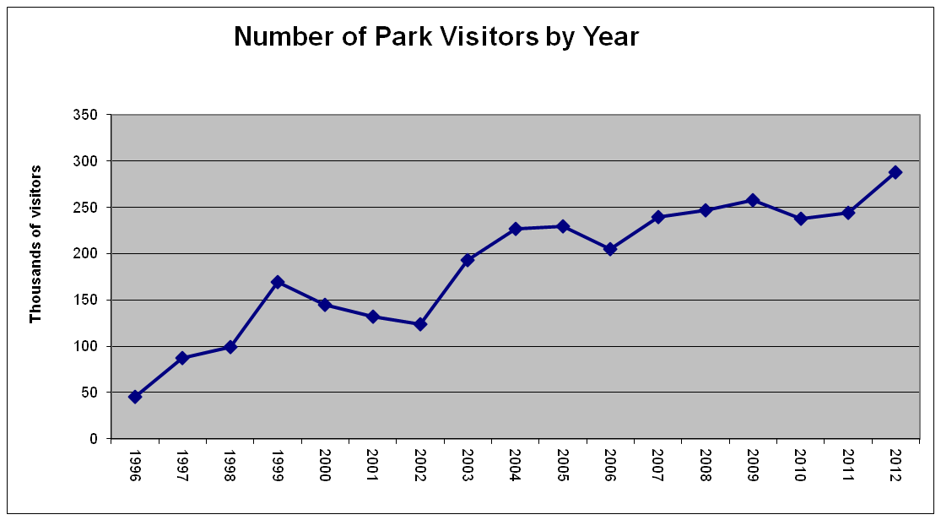
Line Chart Example

Slide 36
Graphs to Describe Numerical Variables
1.5
Numerical Data
Frequency Distributions and
Cumulative Distributions
Stem-and-Leaf
Display
Histogram
Ogive

Slide 37
Frequency Distributions
What is a Frequency Distribution?
A frequency distribution is a list or a table …
containing class groupings (categories or ranges within which the data fall) ...
and the corresponding frequencies with which data fall within each class or category

Slide 38
Why Use Frequency Distributions?
A frequency distribution is a way to summarize data
The distribution condenses the raw data into a more useful form...
and allows for a quick visual interpretation of the data

Slide 39
Class Intervals and Class Boundaries
Each class grouping has the same width
Determine the width of each interval by
Use at least 5 but no more than 15-20 intervals
Intervals never overlap
Round up the interval width to get desirable interval endpoints

Slide 40
Frequency Distribution Example
Example: A manufacturer of insulation randomly selects 20 winter days and records the daily high temperature
data: median = 31 ; mean = 32.4
24, 35, 17, 21, 24, 37, 26, 46, 58, 30,
32, 13, 12, 38, 41, 43, 44, 27, 53, 27
S.D = 12.37

Slide 41
Frequency Distribution Example
(continued)
Sort raw data in ascending order: 12, 13, 17, 21, 24, 24, 26, 27, 27, 30, 32, 35, 37, 38, 41, 43, 44, 46, 53, 58
Find range: 58 - 12 = 46
Select number of classes: 5 (usually between 5 and 15)
Compute interval width: 10 (46/5 then round up)
Determine interval boundaries: 10 but less than 20, 20 but less than 30, . . . , 60 but less than 70
Count observations & assign to classes

Slide 42
Frequency Distribution Example
(continued)
Data in ordered array:
12, 13, 17, 21, 24, 24, 26, 27, 27, 30, 32, 35, 37, 38, 41, 43, 44, 46, 53, 58
Relative
Frequency
Interval Frequency
Percentage
10 but less than 20 3 .15 15
20 but less than 30 6 .30 30
30 but less than 40 5 .25 25
40 but less than 50 4 .20 20
50 but less than 60 2 .10 10
Total 20 1.00 100

Slide 43
Histogram
A graph of the data in a frequency distribution is called a histogram
The interval endpoints are shown on the horizontal axis
the vertical axis is either frequency, relative frequency, or percentage
Bars of the appropriate heights are used to represent the number of observations within each class

Slide 44
Histogram Example
Interval
Frequency
10 but less than 20 3
20 but less than 30 6
30 but less than 40 5
40 but less than 50 4
50 but less than 60 2
(No gaps between bars)
0 10 20 30 40 50 60 70
Temperature in Degrees

Slide 45
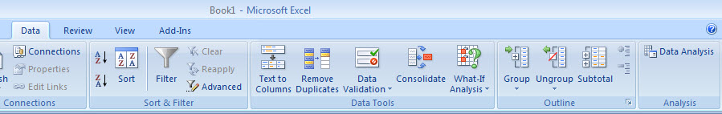
Histograms in Excel
1
2
Select Data Tab
Click on Data Analysis

Slide 46
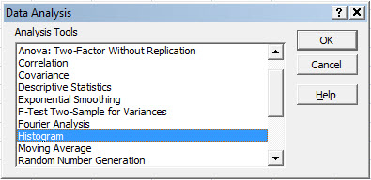
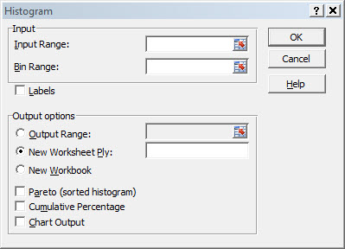
Histograms in Excel
(continued)
3
Choose Histogram
(
Input data range and bin range (bin range is a cell range containing the upper interval endpoints for each class grouping)
Select Chart Output
and click “OK”
4

Slide 47
Questions for Grouping Data into Intervals
1. How wide should each interval be? (How many classes should be used?)
2. How should the endpoints of the intervals be determined?
Often answered by trial and error, subject to user judgment
The goal is to create a distribution that is neither too "jagged" nor too "blocky”
Goal is to appropriately show the pattern of variation in the data

Slide 48
How Many Class Intervals?
Many (Narrow class intervals)
may yield a very jagged distribution with gaps from empty classes
Can give a poor indication of how frequency varies across classes
Few (Wide class intervals)
may compress variation too much and yield a blocky distribution
can obscure important patterns of variation.
(X axis labels are upper class endpoints)

Slide 49
The Cumulative Frequency Distribuiton
Data in ordered array:
12, 13, 17, 21, 24, 24, 26, 27, 27, 30, 32, 35, 37, 38, 41, 43, 44, 46, 53, 58
Cumulative Frequency
Cumulative Percentage
Class
Frequency
Percentage
10 but less than 20 3 15 3 15
20 but less than 30 6 30 9 45
30 but less than 40 5 25 14 70
40 but less than 50 4 20 18 90
50 but less than 60 2 10 20 100
Total 20 100

Slide 50
The Ogive Graphing Cumulative Frequencies
Upper interval endpoint
Cumulative Percentage
Interval
Less than 10 10 0
10 but less than 20 20 15
20 but less than 30 30 45
30 but less than 40 40 70
40 but less than 50 50 90
50 but less than 60 60 100
Interval endpoints

Slide 51
Stem-and-Leaf Diagram
A simple way to see distribution details in a data set
METHOD: Separate the sorted data series into leading digits (the stem) and the trailing digits (the leaves)

Slide 52
Example
Data in ordered array:
21, 24, 24, 26, 27, 27, 30, 32, 38, 41
Here, use the 10’s digit for the stem unit:
Stem Leaf
2 1
3 8
21 is shown as
38 is shown as

Slide 53
Example
(continued)
Data in ordered array:
21, 24, 24, 26, 27, 27, 30, 32, 38, 41
Completed stem-and-leaf diagram:
Stem | Leaves
2 | 1 4 4 6 7 7
3 | 0 2 8
4 | 1

Slide 54
Using other stem units
Using the 100’s digit as the stem:
Round off the 10’s digit to form the leaves
613 would become 6 1
776 would become 7 8
. . .
1224 becomes 12 2
Stem Leaf

Slide 55
Using other stem units
(continued)
Using the 100’s digit as the stem:
The completed stem-and-leaf display:
Data:
613, 632, 658, 717, 722, 750, 776, 827, 841, 859, 863, 891, 894, 906, 928, 933, 955, 982, 1034, 1047,1056, 1140, 1169, 1224
Stem Leaves
6 1 3 6
7 2 2 5 8
8 3 4 6 6 9 9
9 1 3 3 6 8
10 3 5 6
11 4 7
12 2

Slide 56
Scatter Diagrams
Scatter Diagrams are used for paired observations taken from two numerical variables
The Scatter Diagram:
one variable is measured on the vertical axis and the other variable is measured on the horizontal axis

Slide 57
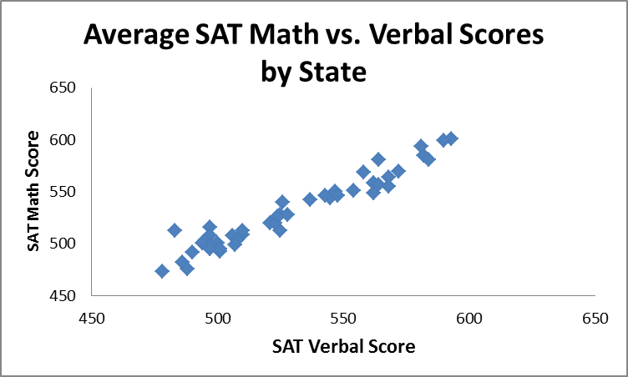
Scatter Diagram Example
Average SAT scores by state: 1998
 | Verbal | Math
Alabama | 562 | 558
Alaska | 521 | 520
Arizona | 525 | 528
Arkansas | 568 | 555
California | 497 | 516
Colorado | 537 | 542
Connecticut | 510 | 509
Delaware | 501 | 493
D.C. | 488 | 476
Florida | 500 | 501
Georgia | 486 | 482
Hawaii | 483 | 513
…
W.Va. | 525 | 513
Wis. | 581 | 594
Wyo. | 548 | 546

Slide 58
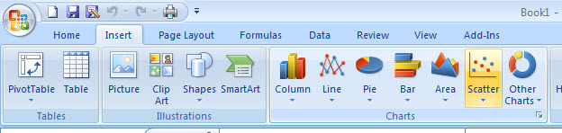
Scatter Diagrams in Excel
1
Select the Insert tab
2
Select Scatter type from the Charts section
3
When prompted, enter the data range, desired legend, and desired destination to complete the scatter diagram

Slide 59
Data Presentation Errors
1.6
Goals for effective data presentation:
Present data to display essential information
Communicate complex ideas clearly and accurately
Avoid distortion that might convey the wrong message

Slide 60
Data Presentation Errors
(continued)
Unequal histogram interval widths
Compressing or distorting the vertical axis
Providing no zero point on the vertical axis
Failing to provide a relative basis in comparing data between groups

Slide 61
Chapter Summary
Reviewed incomplete information in decision making
Introduced key definitions:
Population vs. Sample
Parameter vs. Statistic
Descriptive vs. Inferential statistics
Described random sampling
Examined the decision making process

Slide 62
Chapter Summary
(continued)
Reviewed types of data and measurement levels
Data in raw form are usually not easy to use for decision making -- Some type of organization is needed:
♦ Table ♦ Graph
Techniques reviewed in this chapter:
Frequency distribution
Cross tables
Bar chart
Pie chart
Pareto diagram
Line chart
Frequency distribution
Histogram and ogive
Stem-and-leaf display
Scatter plot

Slide 63

All rights reserved. No part of this publication may be reproduced, stored in a retrieval system, or transmitted, in any form or by any means, electronic, mechanical, photocopying, recording, or otherwise, without the prior written permission of the publisher.
Printed in the United States of America.

